Slide 1


Slide 2


Slide 4

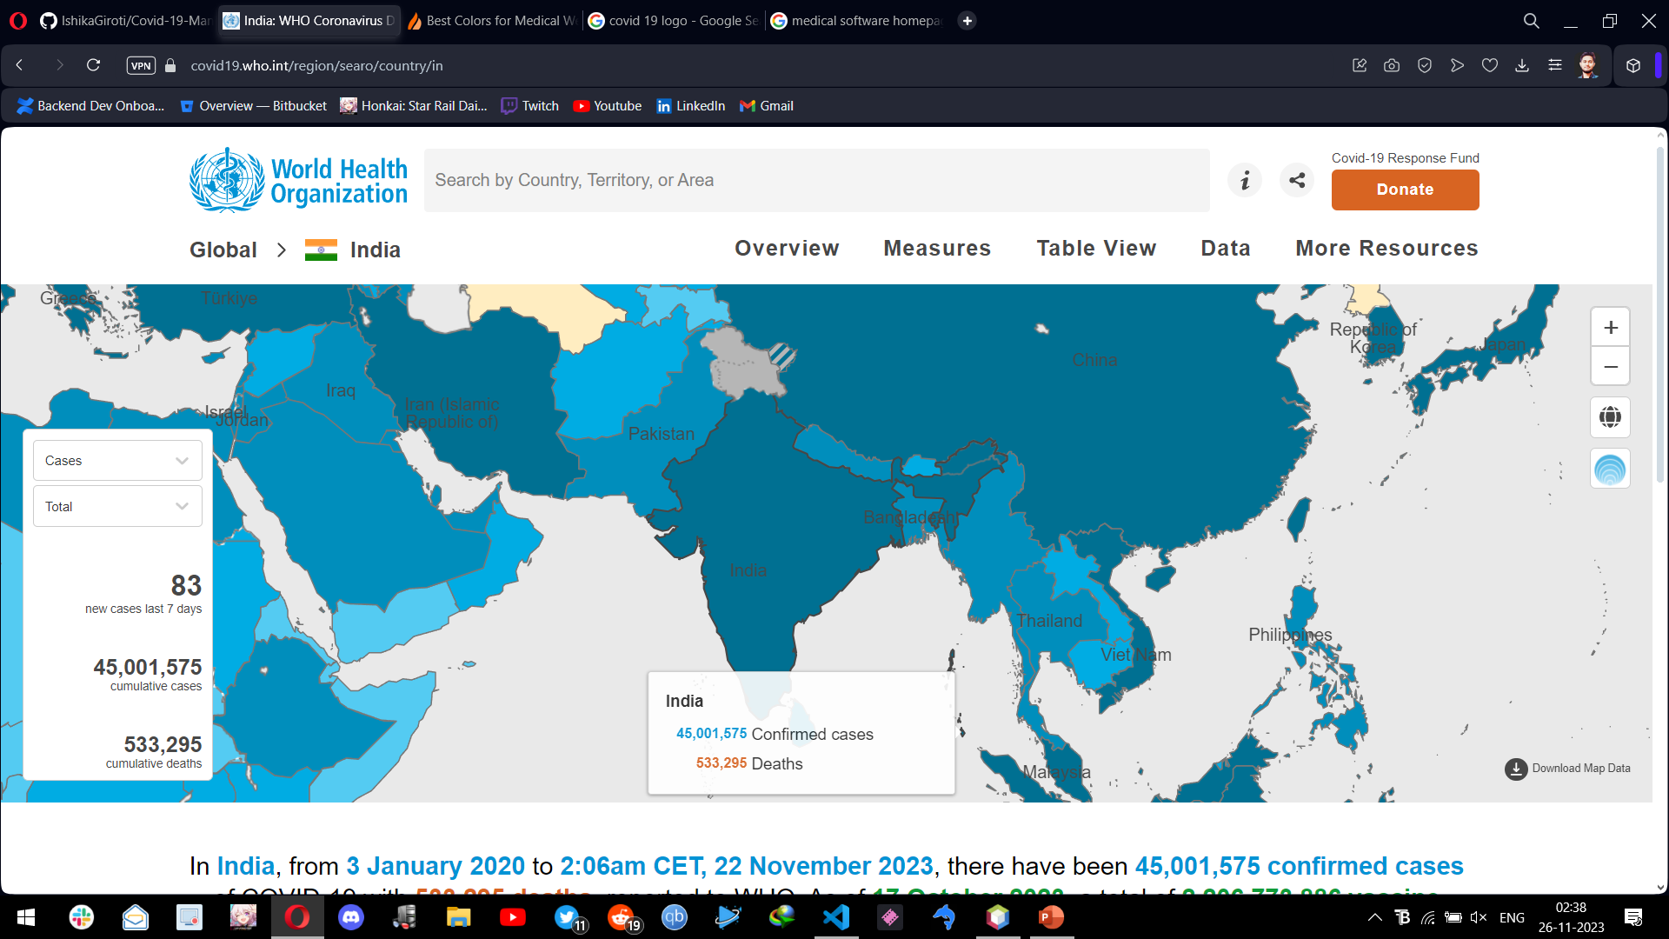
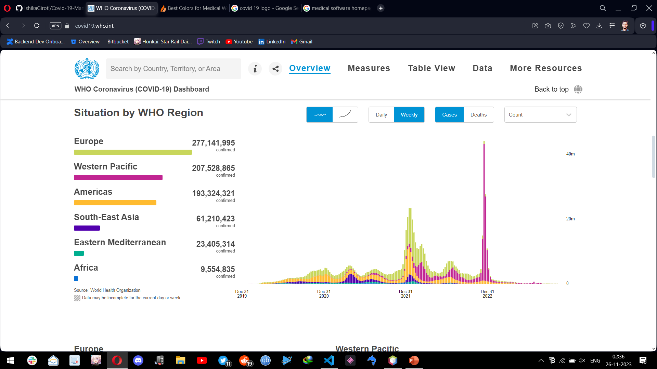
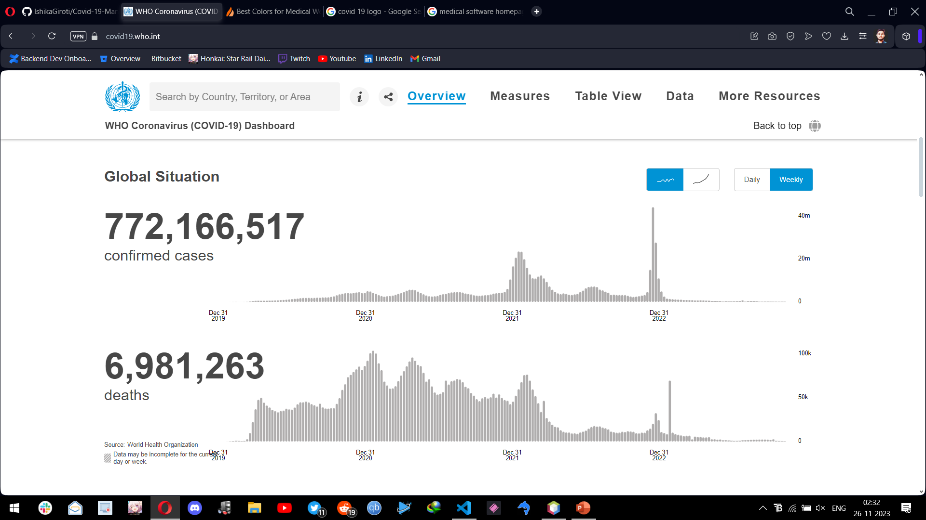
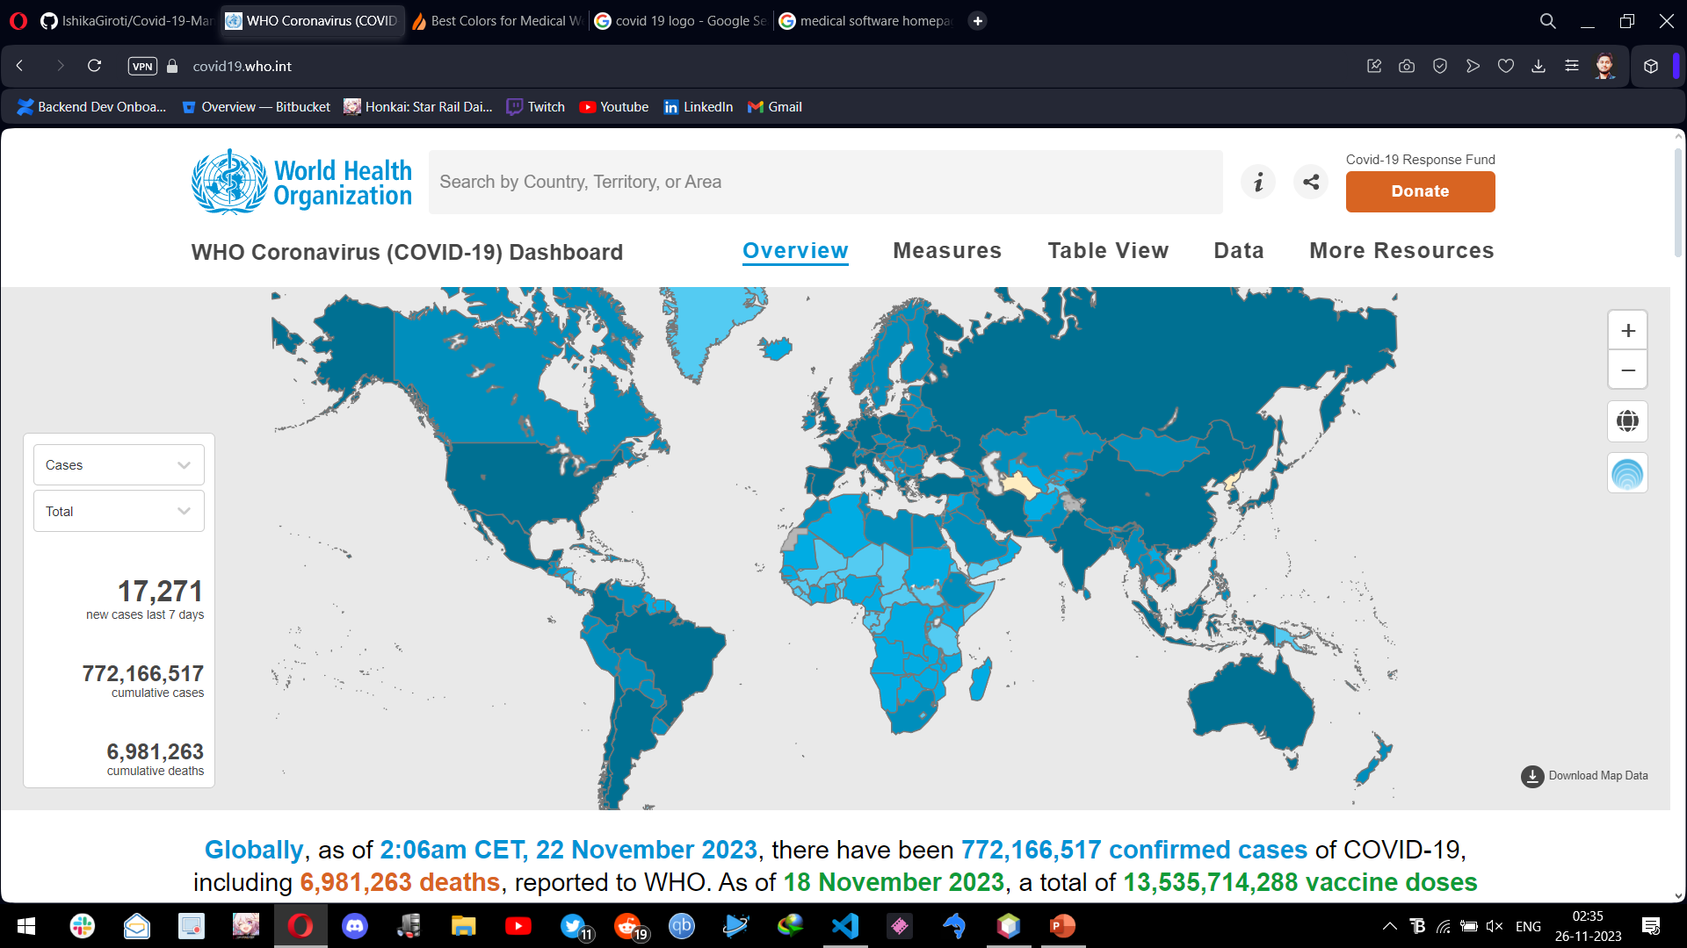
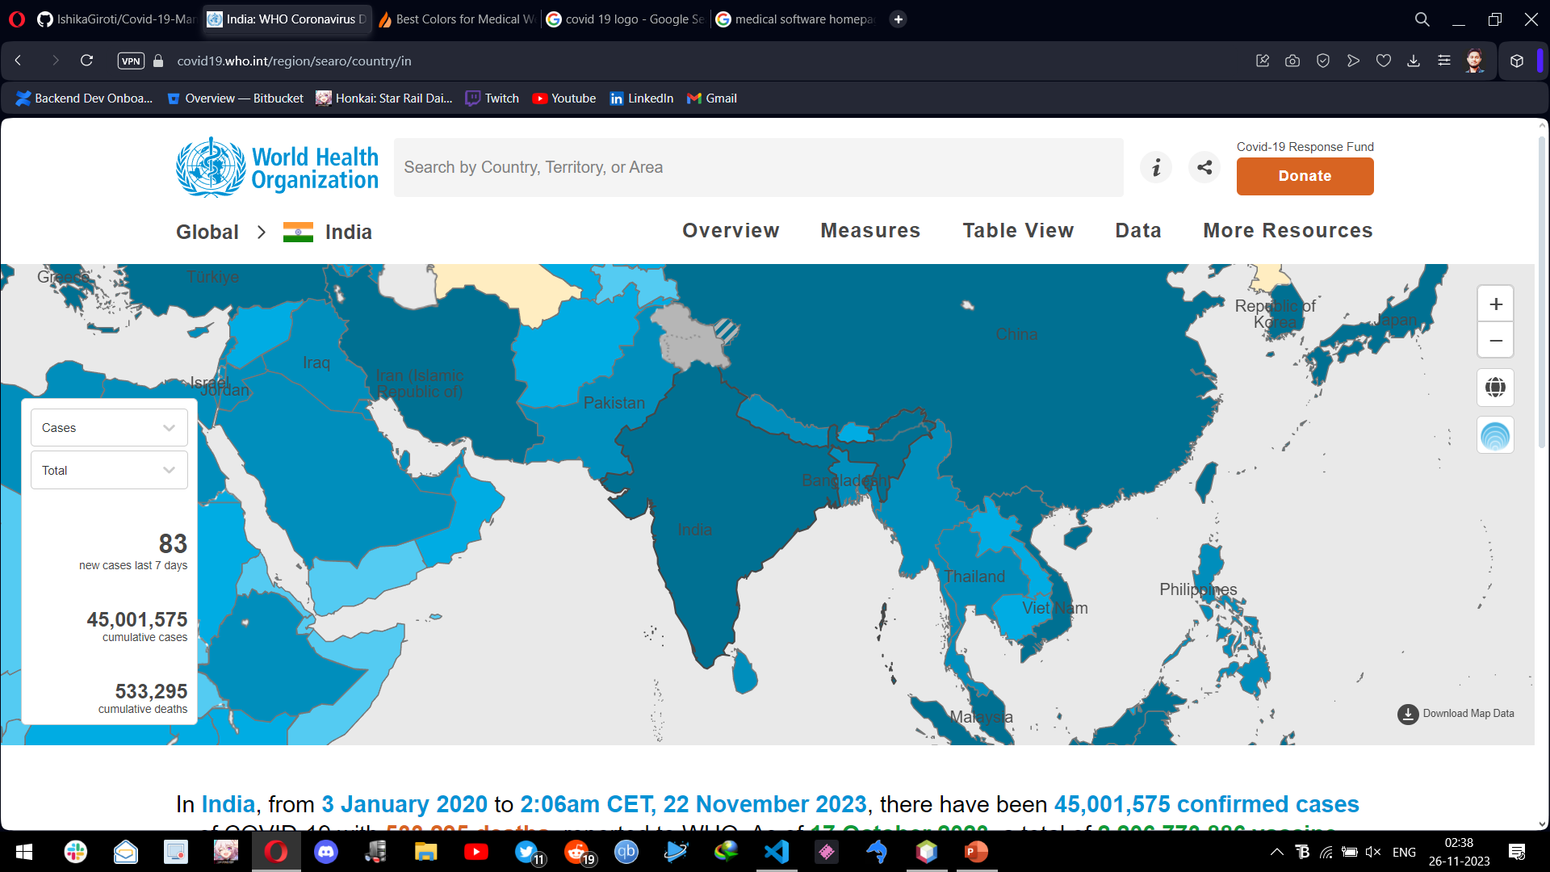
BG
COVID 19 MANAGERTM
COVID MANAGER
USER LOGIN
LAB LOGIN
EXIT
Made by Ayush M Srivastava (M.CA Year II)

Slide 5
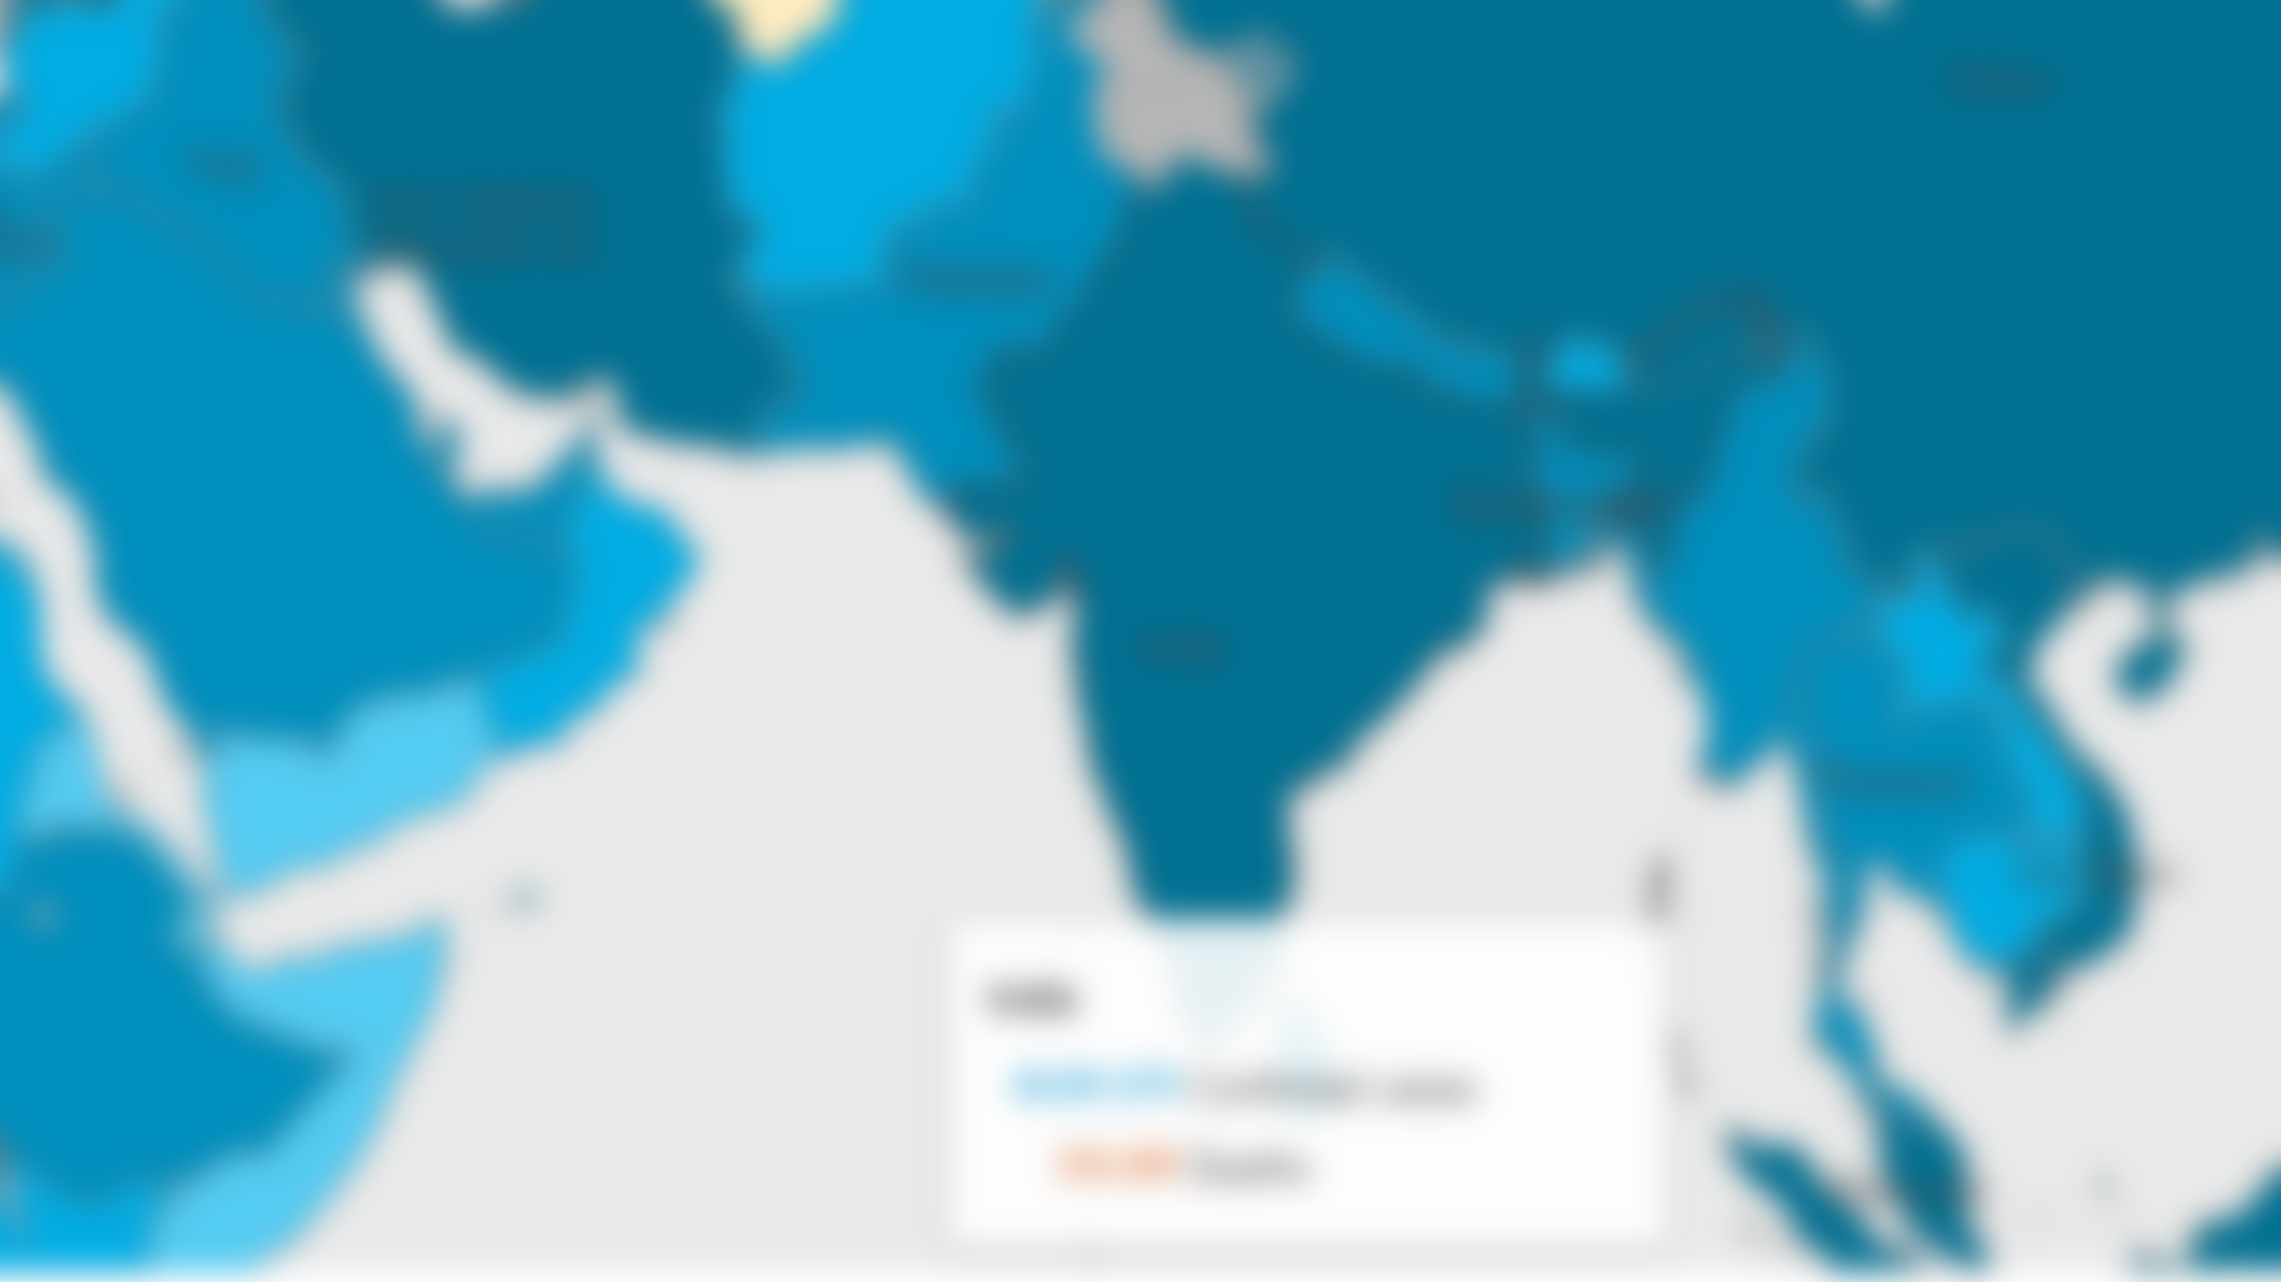
COVID MANAGER

Slide 6
COVID MANAGER
LAB LOGIN
SIGNUP
Made by Ayush M Srivastava (M.CA Year II)

